Slide 1
Characterizing Performance loss from mapping general purpose applications onto GPU architecture
Archit Gupta, Sohum Datta

Slide 2
CONTROL DIVERGENCE
GPU ARCHITECTURE

Slide 3
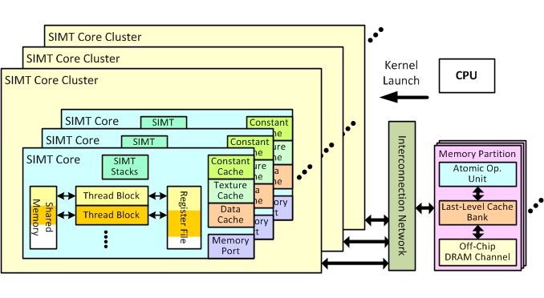
**Architecture of GPGPU-SIM (developed by Tor Aamodt at University of British Columbia)

Slide 4
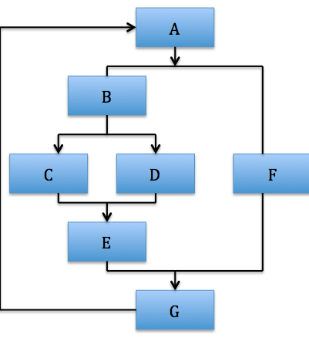
SIMD architecture - Originates from vector supercomputers
Mainly oriented towards graphics processing where a single set of operations need to be applied on a massive set of data. Eg: Adjusting screen brightness
Some of the characteristics of a modern day GPU
Bare minimum execution pipelines (in-order, w/o branch prediction, lock-step execution of multiple threads etc)
Large number of lightweight cores (SMs) with large register files, capable of switching context every cycle
Lock-step execution of thread groups (called warps) leads to control hazards, referred to as branch divergence

Slide 5
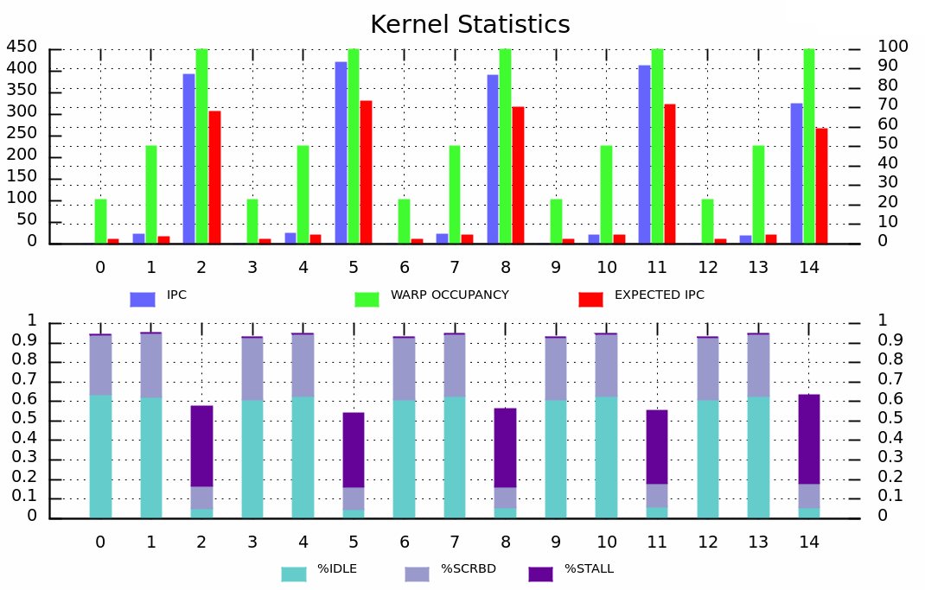
Branch divergence consumes a significant portion of the GPU execution time
**Analyzing GPU workloads for control dependent inefficiencies in the GPGPU architecture - Nehal Bhandari, Archit Gupta

Slide 6
CHARACTERIZING BRANCHES
INTRINSIC AND EXTRINSIC BRANCHES

Slide 7
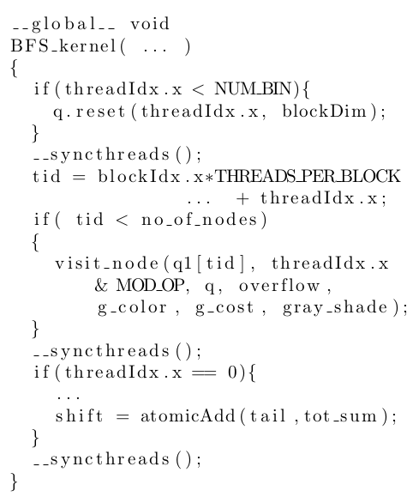
Which branches are intrinsic and which are extrinsic?
PARBOIL benchmark suite - Breadth First Search

Slide 8
Branches can be intrinsic to an algorithm
Intrinsic Branches
Extrinsic Branches
Performance Impact
CPU codes gives us the intrinsic branches
Intrinsic branches in CPU code is related to the CUDA code to point out the intrinsic control. Any other branches/controls present in the CUDA code are extrinsic.
Locate the extrinsic branches in the GPU code
Some branches are the result of mapping an algorithm onto a GPU, called extrinsic branches. They arise because a general purpose program is run an a GPU.
Map branches in simulated binaries to High-level code
Extrinsic branches in CUDA code is traced to compiled code and is instrumented to measure performance loss due to their divergence.

Slide 9
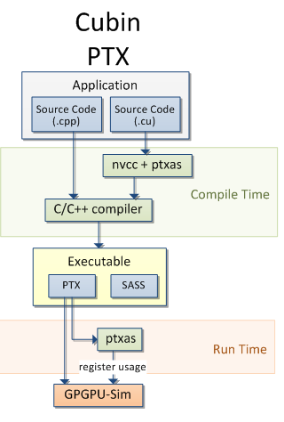
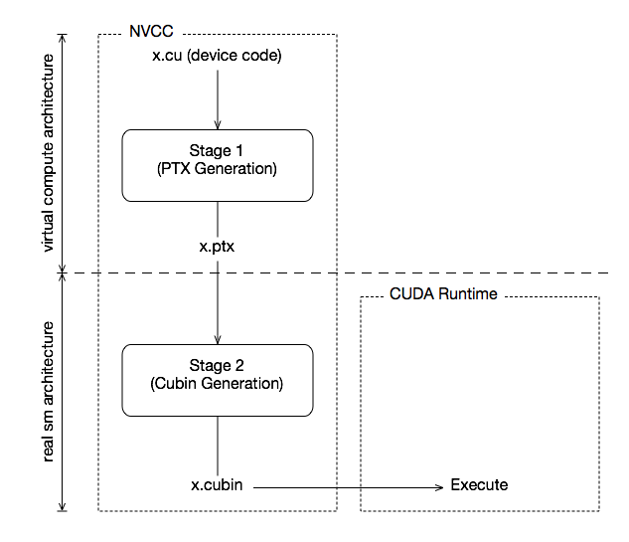
**NVIDIA CUDA Compiler NVCC v7.5 Documentation (http://docs.nvidia.com/cuda/cuda-compiler-driver-nvcc)
****CUDA-sim Functional Simulation Engine, GPGPU-sim v3.x

